Slide 1
APOLOGETICS
IN ONE LESSON
almost
Ai1L.net
Lesson 18
“Isaiah 53 is not a good example of fulfilled prophecy”

Slide 2
“Now I remember that, on one occasion, at a disputation held with certain Jews, who were reckoned wise men, I quoted these prophecies; to which my Jewish opponent replied, that these predictions bore reference to the whole people, regarded as one individual.”
Origen Contra Celsum

Slide 3
Could Isaiah 53 be referring to the remnant of Israel?
1

Slide 4
1 | Historically, this is weird interpretation
2 | Israel could not bear its own sins
3 | Israel was not without sin
4 | The text is singular when it refers to the servant
5 | Israel was not destroyed

Slide 5
Does the interpretation of Jesus as the Messiah fit the context of the Babylonian exile?
2

Slide 6
How can Jesus be the Messiah of Isaiah 53 when the Gospels said that crowds followed Jesus?
3

Slide 7
Isaiah says the Messiah will be sickly and die of disease, unlike Jesus.
4

Slide 8
Isaiah 53 doesn’t explicitly say that the servant will rise from the dead.
5

Slide 9
Isaiah 53 says the servant did no violence; yet Jesus cleared the Temple with a whip!
6

Slide 10
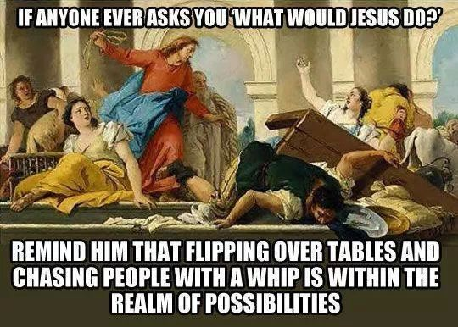

Slide 11
Isaiah 53 doesn’t explicitly say that the servant will rise from the dead.
7

